Slide 1

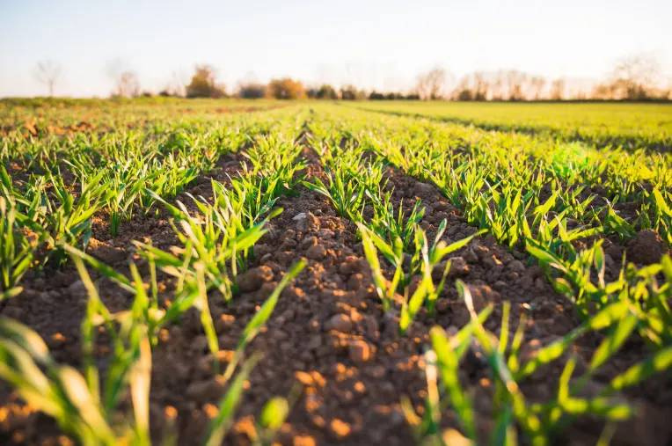
HarvestHeal :
Empowering Agriculture through crop doctor

Slide 2
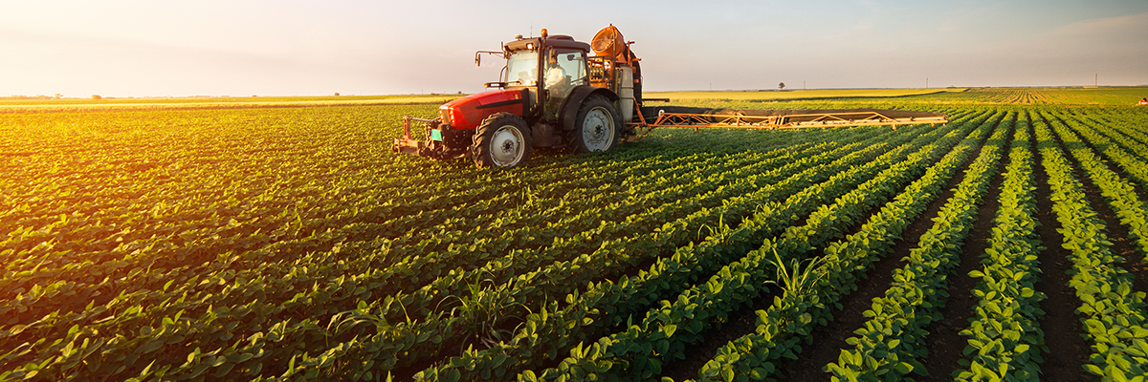
HarvestHeal – Empowering Agriculture through Crop Doctor
Introducing HarvestHeal, a revolutionary agricultural platform that utilize cutting-edge technology to empower farmers and transform crop management. Exploiting advanced diagnostics and data-driven insights, HarvestHeal equips growers with the tools to optimize yields, reduce waste, and cultivate a more sustainable future.

Slide 3
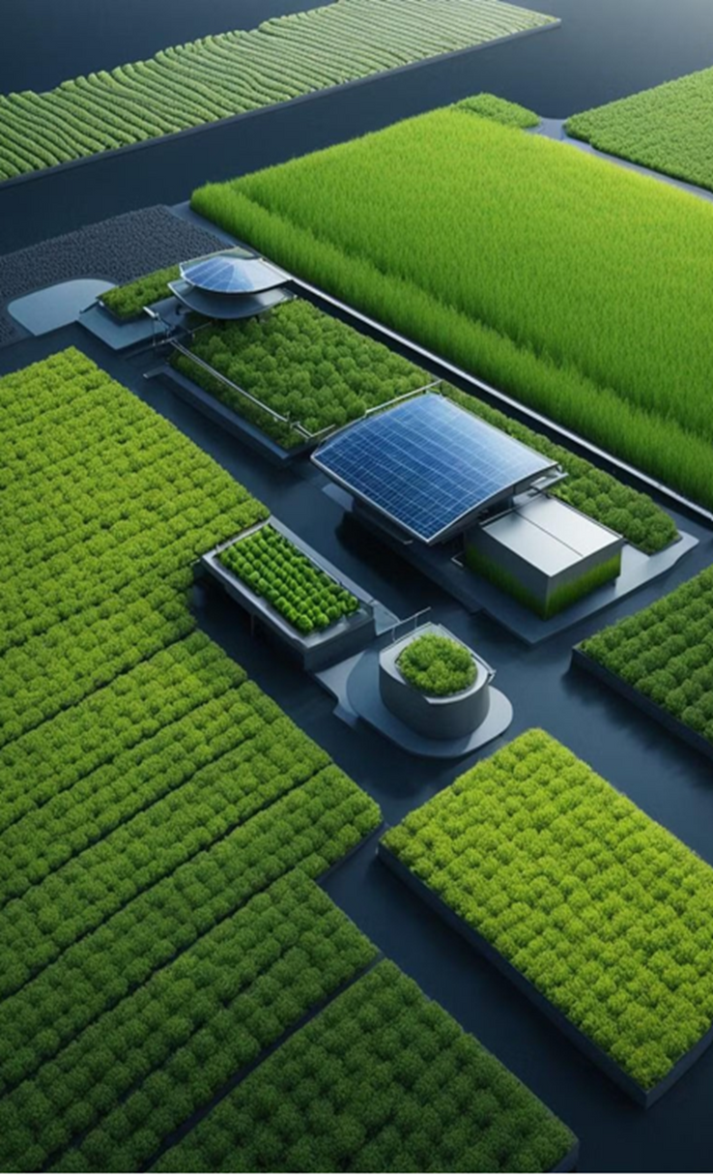
Introduction
The global agricultural landscape faces numerous challenges, including climate change, crop diseases, and soil degradation. These threats jeopardize food security and sustainable farming practices worldwide. However, by leveraging cutting-edge technology, we can empower farmers to overcome these obstacles and unlock new opportunities for growth.
Introducing HarvestHeal, a comprehensive solution that combines advanced machine learning and AI to revolutionize the way farmers approach crop management. HarvestHeal provides a suite of tools designed to help farmers make informed decisions, optimize their operations, and enhance their yields, ultimately contributing to global food security and environmental sustainability.

Slide 4
Problem Statement
1. Farmers worldwide face significant challenges from climate change,leading to unpredictable weather patterns, droughts, and extreme weather events that threaten crop yields and food security.
2.The spread of crop diseases and plant infestations can devastate agricultural production, requiring intensive use of pesticides and compromising the health of the land.
3.Unsustainable farming practices, including overuse of fertilizers and poor soil management, have contributed to soil degradation, reducing the overall fertility and productivity of agricultural lands.
These interconnected challenges have a severe impact on global food security and the long-term sustainability of the agricultural sector. Innovative solutions are needed to empower farmers and ensure a thriving, resilient food system for the future.

Slide 5
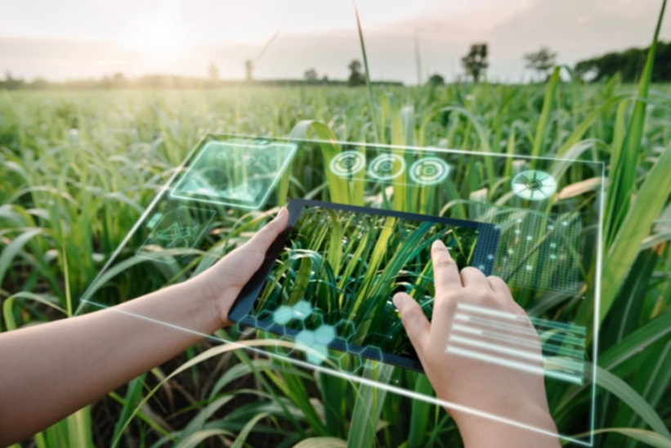
Solution Overview
HarvestHeal offers a comprehensive solution to empower farmers and address global agricultural challenges. Our platform integrates cutting-edge machine learning and AI technologies to provide intelligent crop selection, disease detection, and personalized fertilizer recommendations.
HarvestHeal offers a comprehensive solution to empower farmers and address global agricultural challenges. Our platform integrates cutting-edge machine learning and AI technologies to provide intelligent crop selection, disease detection, and personalized fertilizer recommendations.

Slide 6
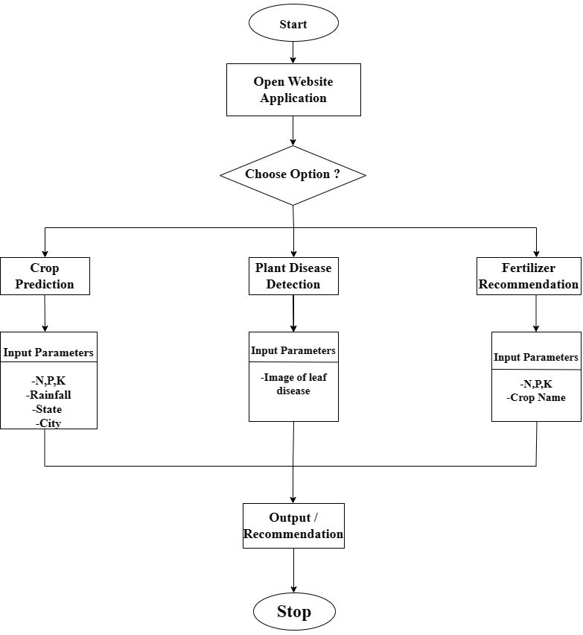
Flowchart

Slide 7
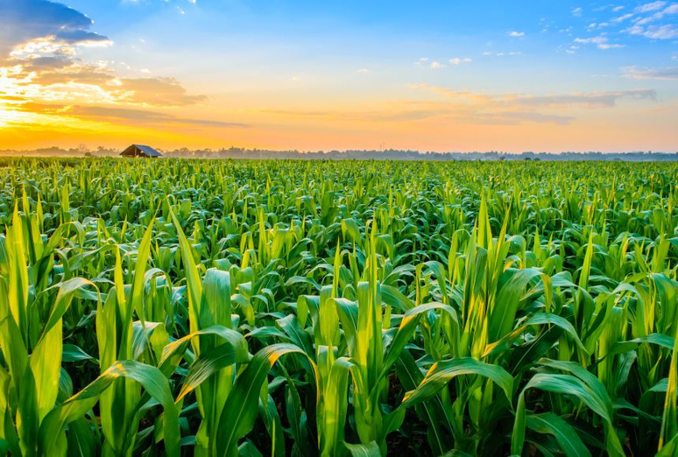
Crop Selection Tool
HarvestHeal's powerful crop selection tool empowers farmers to make informed decisions about which crops to cultivate. By analyzing factors like climate, soil type, and market demand, the tool provides personalized recommendations to optimize yields and profitability.
With this advanced feature, farmers can confidently choose the right crops for their unique growing conditions, maximizing the potential of their land and resources.

Slide 8
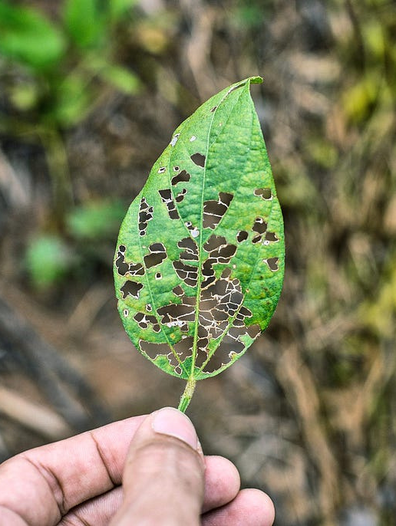
Disease Detection System
HarvestHeal's advanced disease detection system utilizes cutting-edge image recognition and machine learning algorithms to swiftly identify plant diseases. By analyzing high-resolution images of crops, the system can detect even subtle symptoms, enabling early intervention and effective disease management.
This powerful tool empowers farmers to proactively protect their crops, minimizing yield losses and safeguarding food security. With HarvestHeal, farmers can stay one step ahead of crop diseases, ensuring the healthy growth and development of their plants.

Slide 9
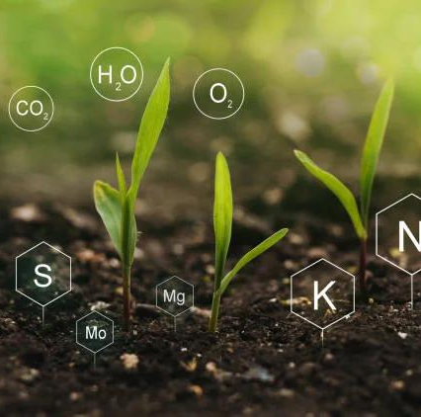
Fertilizer Recommendation System
HarvestHeal's fertilizer recommendation feature leverages soil analysis data and crop requirements to provide farmers with optimized fertilizer application plans. By tailoring nutrient inputs to the specific needs of each field, the system helps improve soil health and enhance crop yields.
The advanced algorithms analyze factors like soil composition, nutrient levels, and the unique needs of different crops, delivering precise fertilizer recommendations that maximize productivity while minimizing waste and environmental impact.

Slide 10



Agile Development
1
We followed an agile software development methodology, with rapid iterations and continuous testing to ensure product quality.
2
Extensive Testing
Our testing protocols included unit tests, integration tests, and end-to-end tests to validate the accuracy and reliability of the system.
Pilot Deployment
3
We conducted a pilot deployment with a select group of farmers to gather real-world feedback and refine the system based on user insights.

Slide 11
Online Deployment and Accessibility
Intuitive Online
Platform
Global
Accessibility
Continuous
Improvement
Scalable
Infrastructure
HarvestHeal's online platform provides an easy-to-use interface for farmers to access the full suite of crop optimization tools. The platform is designed with an intuitive user experience in mind, allowing even those with limited technical expertise to navigate seamlessly.
Recognizing the diverse needs of farmers worldwide, HarvestHeal's platform is accessible in multiple languages and optimized for use on mobile devices. This ensures that smallholder farmers in remote regions can also benefit from the transformative power of our technology.
We are committed to the ongoing evolution of HarvestHeal, regularly updating the platform with new features, enhanced algorithms, and real-time data integration. This allows us to continuously improve the accuracy and effectiveness of our crop optimization solutions, empowering farmers to adapt to the ever-changing agricultural landscape.
We are committed to the ongoing evolution of HarvestHeal, regularly updating the platform witThe underlying infrastructure of HarvestHeal's online platform is designed for scalability, ensuring seamless performance and data processing capabilities as our user base grows.

Slide 12

Impact
01
02
03
Environmental Sustainability
Global Food Security
Adaptive Farming
HarvestHeal's data-driven approach promotes sustainable farming practices, helping to reduce the environmental footprint of agriculture and ensure long-term food production.
By empowering farmers worldwide with cutting-edge technology, HarvestHeal contributes to improving crop yields and resilience, bolstering global food supplies and accessibility.
HarvestHeal equips farmers with the knowledge and tools to adapt to the challenges posed by climate change, ensuring the continued viability of their operations.

Slide 13


Conclusion
Summary of Key Points
Call to Action
HarvestHeal's platform enables sustainable farming practices and supports global food security.
We encourage participation and support for HarvestHeal to empower and uplift farmers worldwide.
Thank You

